Slide 1
Push-Relabel Algorithm

Slide 2
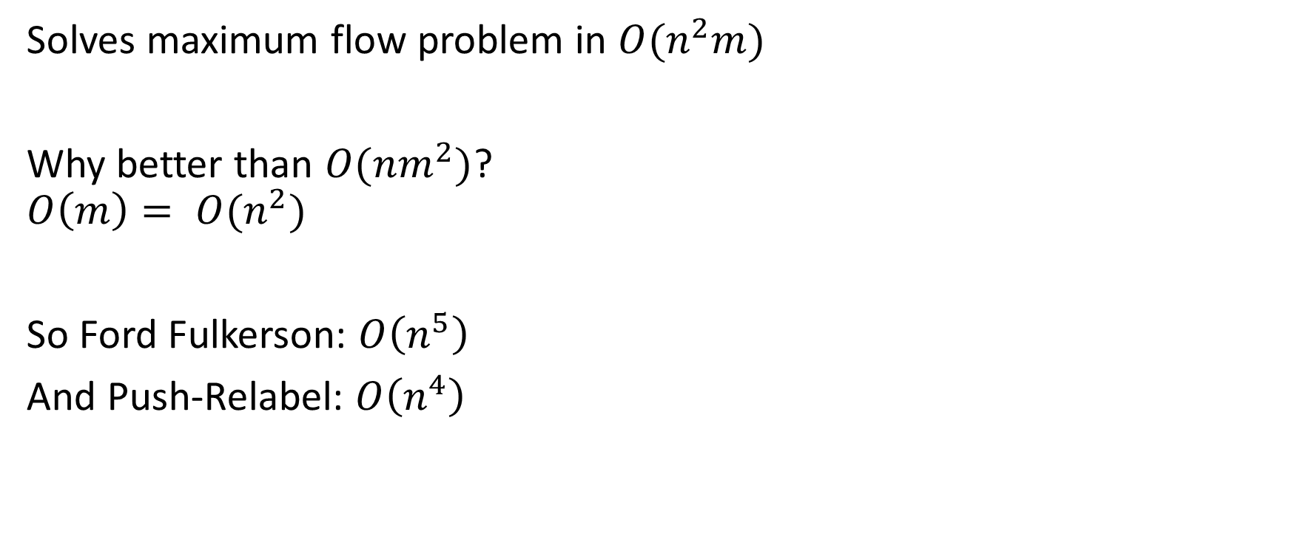
What it does
Solves maximum flow problem in $O(n^{2}m)$
Why better than $O(nm^{2})$?
$$O\left(m\right)= O(n^{2})$$
So Ford Fulkerson: $O\left(n^{5}\right)$
And Push-Relabel: $O\left(n^{4}\right)$

Slide 3
How it works (1)
Graph (G):
G = (V, E)
flow network (F):
F = (G, s, t)
vertex excess (x):
x_{u} = flow_{in} - flow_{out}
residual edge (c):
c_{u,v} = E_{u,v} - F_{u,v}
vertex label (l):
l_{u} = 0
l_{s} = V

Slide 4
How it works (2)
Push (u):
foreach residual edge:
if label(u) == label(v) + 1:
push excess through edge
make residual edge
Relabel (u):
foreach residual edge:
if label(u) >= label(v) + 1
return
label(u) = label(min_{v}) + 1

Slide 5
Correctness
Searches for augmenting paths.
Flow saturates from the source to the sink. Once no edges are found that can be pushed and relabel reaches |v| it is forced to push back towards the source which has label = |v|.

Slide 6
Run Time
Loop: O(V²)
Pick an active vertex and do a push/relabel at most V times.
Push: O(E)
Push any excess through each residual edge.
Relabel: O(E)
Check each residual edge to get the min label and add 1.
O(V*V(E+E)) = O(V²E)

